Slide 1
GROUP 4 PROJECT 3
ACHARYA AKHILESH GIRISH
DENNIS CHEN CHEE HAO
MA JIAN SCHAUN

Slide 2
PROBLEM
Dynamic Programming: Knapsack Problem

Slide 3
(1) Give a recursive definition of the function P(C).
P(C) = max(P(C),p0+P(C-w0), p1+P(C-w1), ..., p(n-1)+ P(C-w(n-1))
C = capacity, w = weight, p = profit, n = type of object

Slide 4

(2) Draw the subproblem graph for P(14) where n is 3 with the weights and profits given below.
14
(14-w2) = 6
+p2
(14-w1) = 8
+p1
(14-w0) = 10
+p0
(8-w0) = 4
+p0
(8-w2) = 0
+p2
(10-w2) = 2
+p2
(10-w0) = 6
+p0
(8-w1) = 2
+p1
(10-w1) = 4
+p1
(6-w0) = 2
+p0
(4-w0) = 0
+p0
(6-w1) = 0
+p1

Slide 5
(3) Give a dynamic programming algorithm to compute the maximum profit, given a knapsack of capacity C, n types of objects with weights wi and profits pi using the bottom up approach.
def knapsack(C, n, pi, wi):
for (i = 0 to C):
P[i] = 0
for (i = 0 to C):
for (j = 0 to (n-1)):
if (wi[j] <= i):
P[i] = max(P[i], P[i - wi[j]] + pi[j])
return P[C]

Slide 6
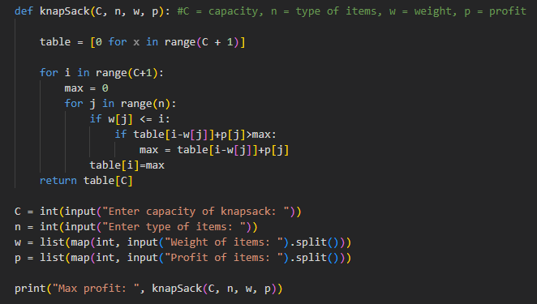
(4) Code your algorithm in a programming language

Slide 7
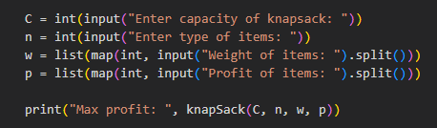
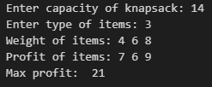
(4)(a) show the running result of P(14) with weights and profits given in (2)

Slide 8
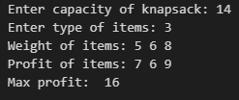

(4)(b) show the running result of P(14) with weights and profits given below.

